Slide 1

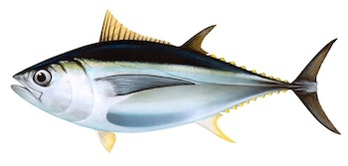

IOTC-2021-TCMP04-08
CURRENT STATUS OF IOTC
MANAGEMENT STRATEGY EVALUATIONS
Bigeye Tuna
Dale Kolody & Paavo Jumppanen – CSIRO
With guidance from the IOTC WPM MSE Task Force

Slide 2

Bigeye MSE Outline
Funding Support:
Phase 3 ends June 2021
Phase 4 funding from Australia to June 2023
CSIRO and Department of Foreign Affairs and Trade, Australia
Operating Model (simulator):
Not yet endorsed by SC
No revisions proposed by WPTT or WPM since 2019
Tuning Objectives:
MP results for TCMP 2019 tuning objectives appear reasonable
Candidate Management Procedures and Evaluation Results
CPUE-based
Model-based “hockeystick” function
New model-based with projections (K2SM analogy)
TCMP-04 Feedback for next iteration

Slide 3
TCMP-03 (2019) : 2 Tuning Objectives
B1: Pr(Kobe green zone 2030:2034) = 0.5
B2: Pr(Kobe green zone 2030:2034) = 0.6
B3: Pr(Kobe green zone 2030:2034) = 0.7
The stock status is in the Kobe green quadrant over the period 2030:2034 exactly 60 or 70 % of the time (averaged over all simulations).

Slide 4
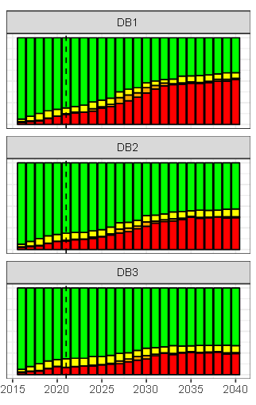
Visualizing the 2018 Tuning Objectives: Time series of Kobe quadrant probabilities
B1: 50% Kobe green zone
B2: 60% Kobe green zone
B3: 70% Kobe green zone

Slide 5
TCMP-03 MP development guidance
Other MP implementation constraints:
Frequency of quota setting
First MP setting in 2022 for 2023 TAC
Then every 3 years
TAC change constraints
Maximum 15% change (increase or decrease)
(easily achievable for all BET tuning objectives)
2 year Implementation data lag
E.g. 2021 CPUE available for 2023 TAC setting

Slide 6
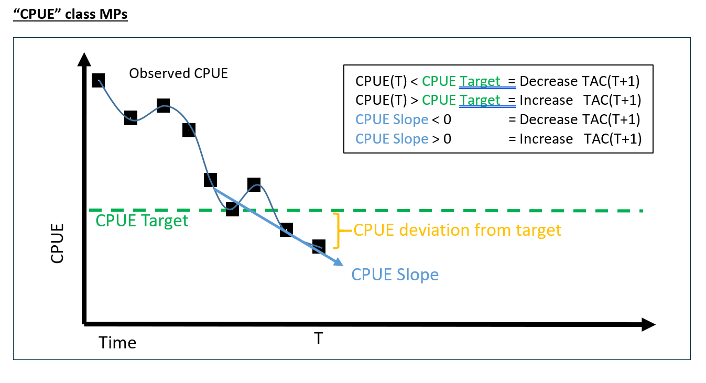
Fig. 1. “Empirical” CPUE-based MP

Slide 7
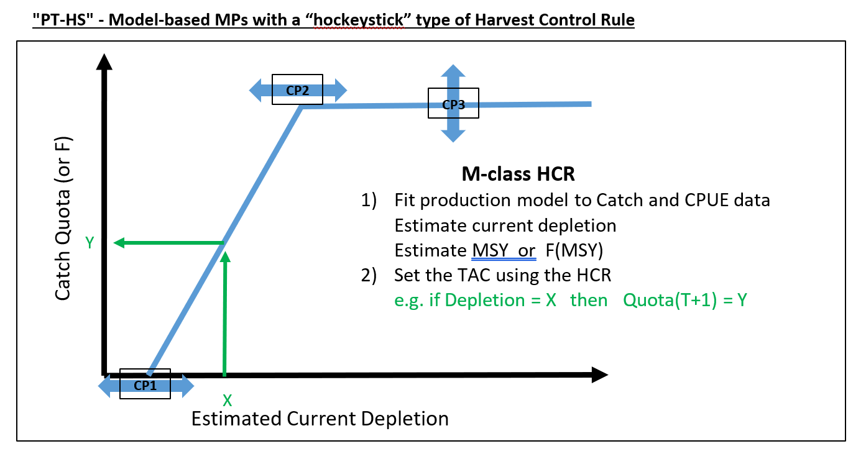
Fig. 2. Original Model-based MP

Slide 8
Fig. 3. New Model-based MP with internal projection
Fit simple population model
Find constant TAC that hits target depletion at target date
Resembles Kobe 2 Strategy Matrix application
CP2
B/B0 (Depletion)
Target depletion
CP1
Historical
Projection
Time
TAC setting
Target Date

Slide 9
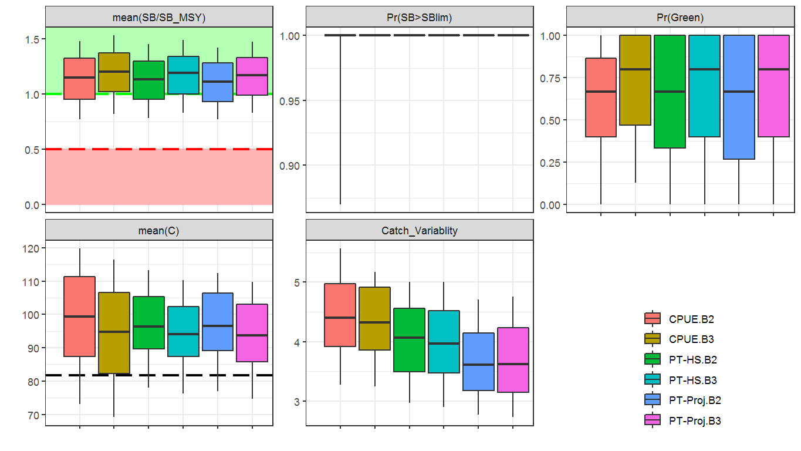
B2
B3
B2
B3
Fig. 4
2023-2037
MP Performance Summary
Results similar to 2019 (TCMP-03)
All MPs have similar low conservation risk (B2 lower SB than B3)
All MPs likely to result in catch that exceeds recent catch
Higher Catch = Lower SB
Projection-based MP, has less catch variability
Minimal risk of
breaching SB limit

Slide 10
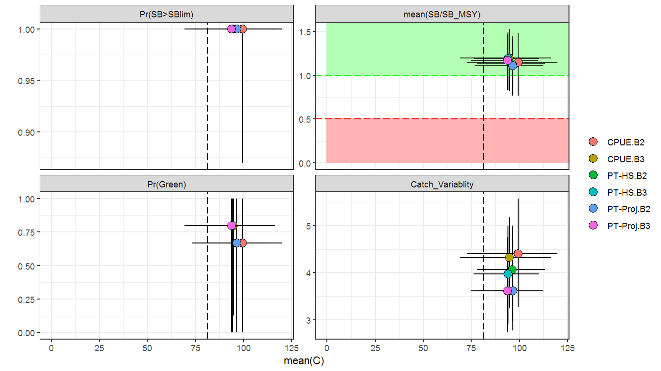
Fig. 5
2023-2037
MP Performance Summary
Trade-off plots
MP Performance very similar
Current Catch

Slide 11
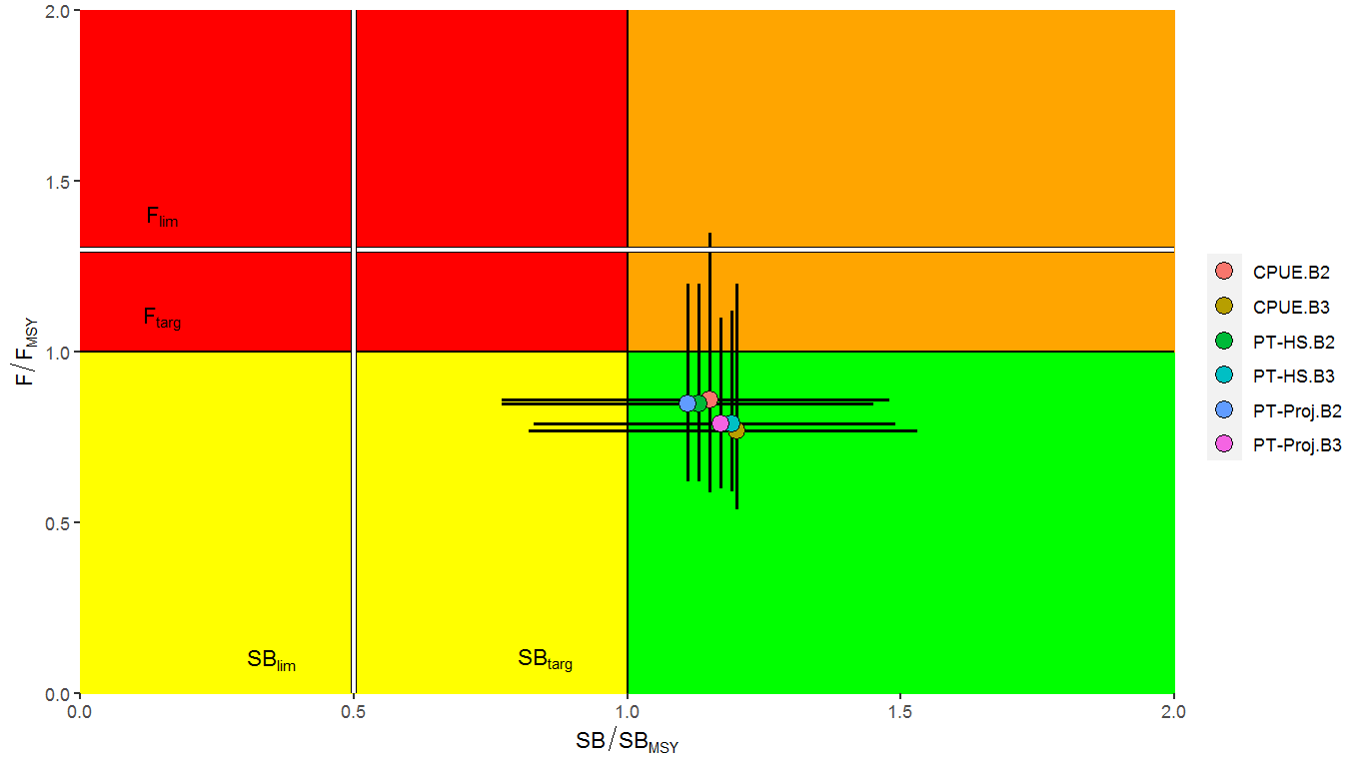
Fig.6
2023-2037
MP Performance Summary

Slide 12
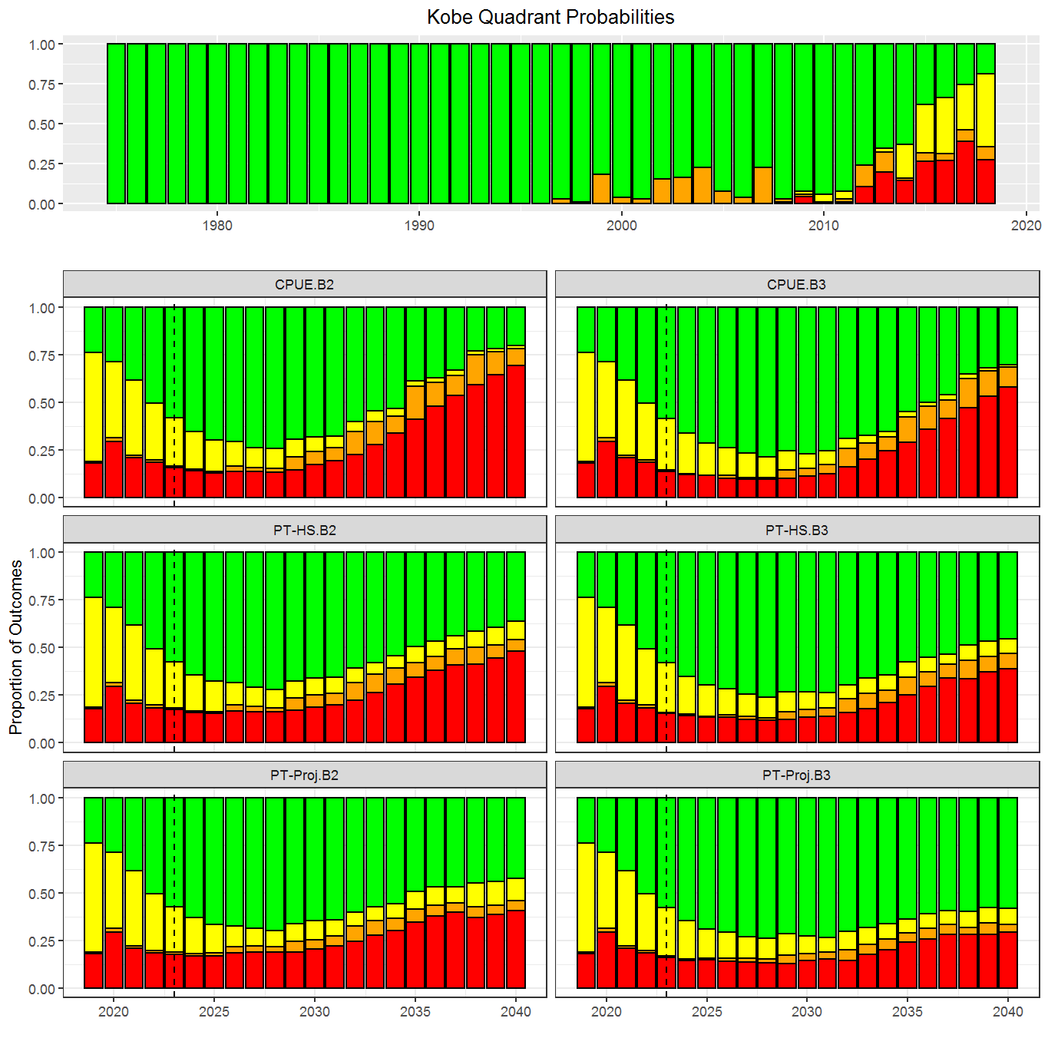
Fig. 7
Kobe plot time series
B2 = 60% green
Time
(Tuning period)
B3 = 70% Green

Slide 13
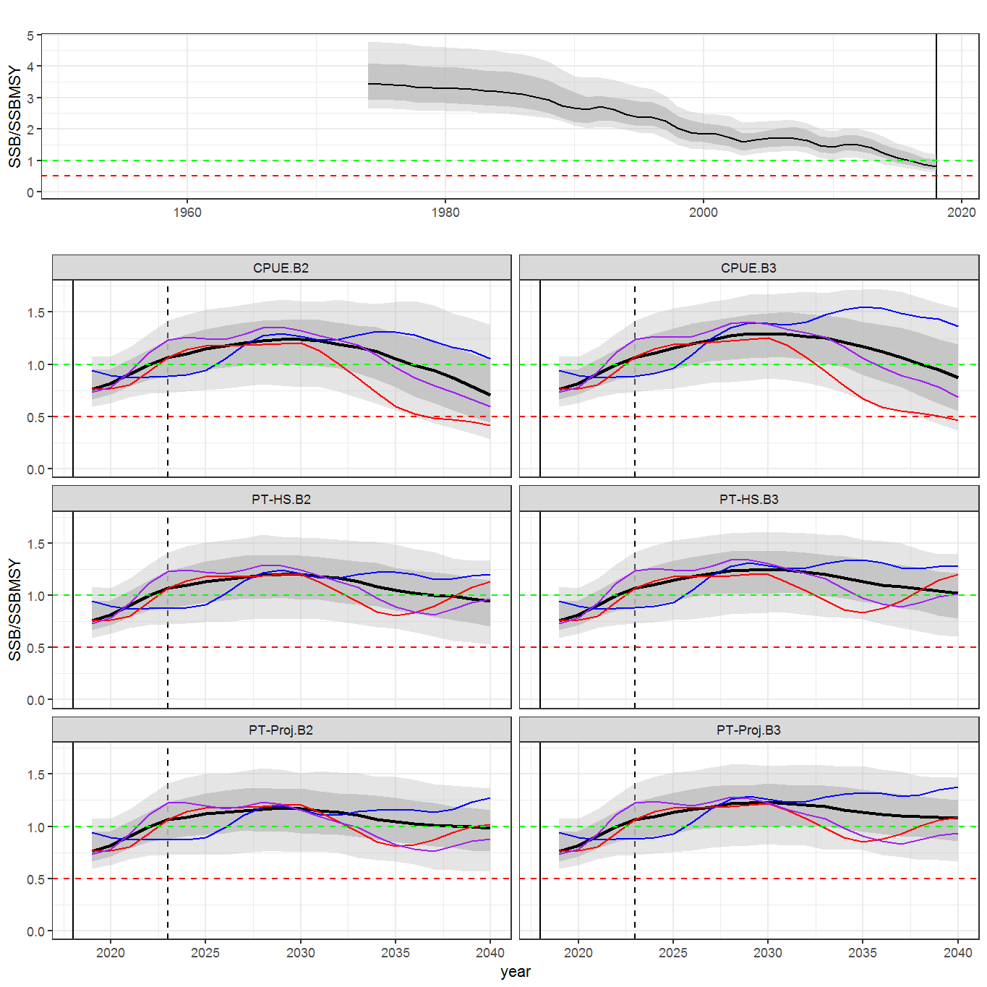
Key Results of Candidate MP Evaluations
Spawning Biomass
Fig. 8
Recent low catches result in Biomass increase prior to first MP setting
MP must cause biomass decline to meet defined tuning objectives
CPUE-based MP is the least stable ~2040
Projection-based MP is the most stable ~2040

Slide 14
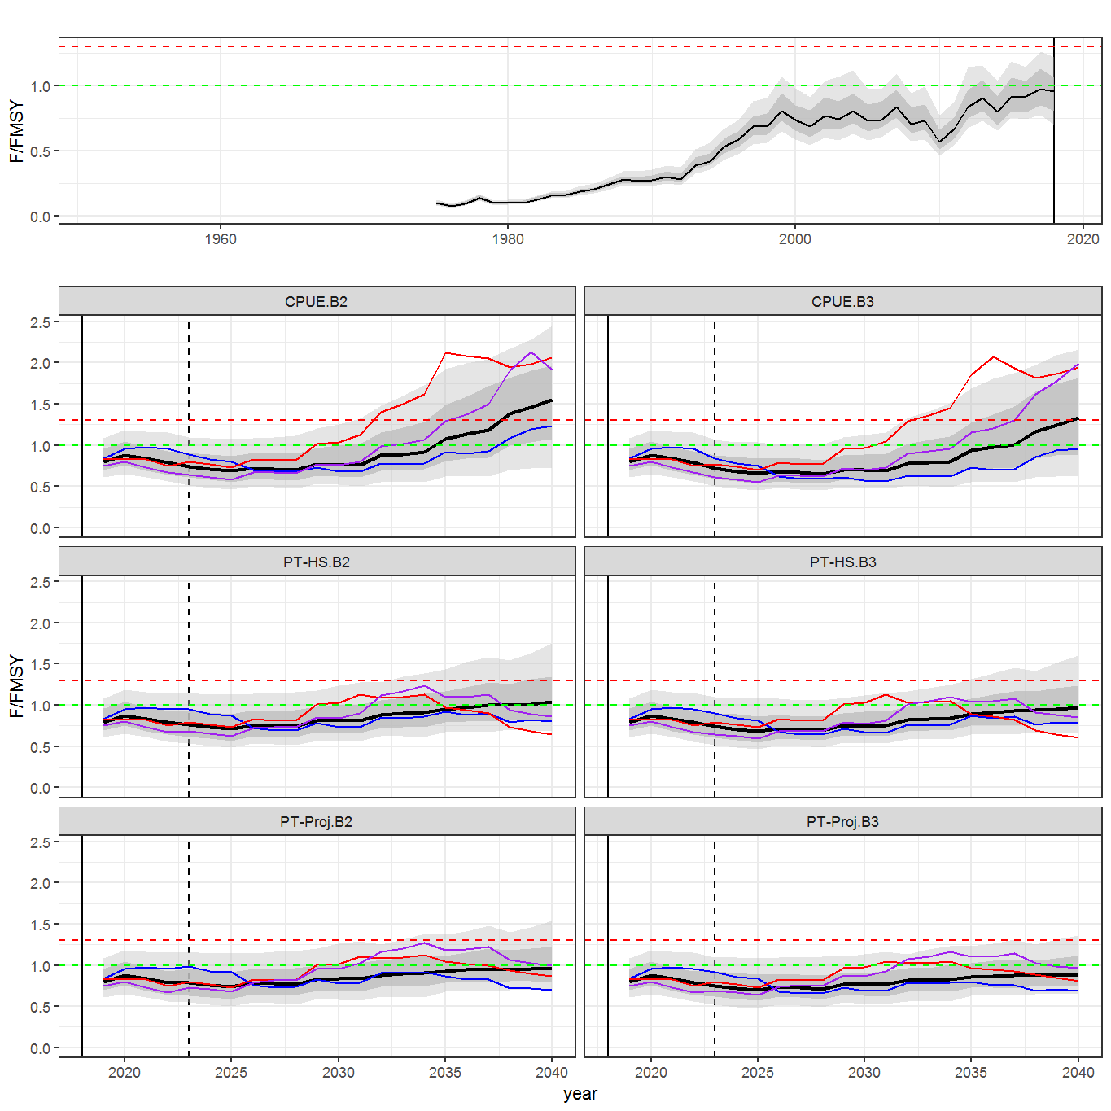
Key Results of Candidate MP Evaluations
Fishing Intensity
Fig. 9
F sometimes very high post 2030
CPUE-based MP worst
Projection-based MP best

Slide 15
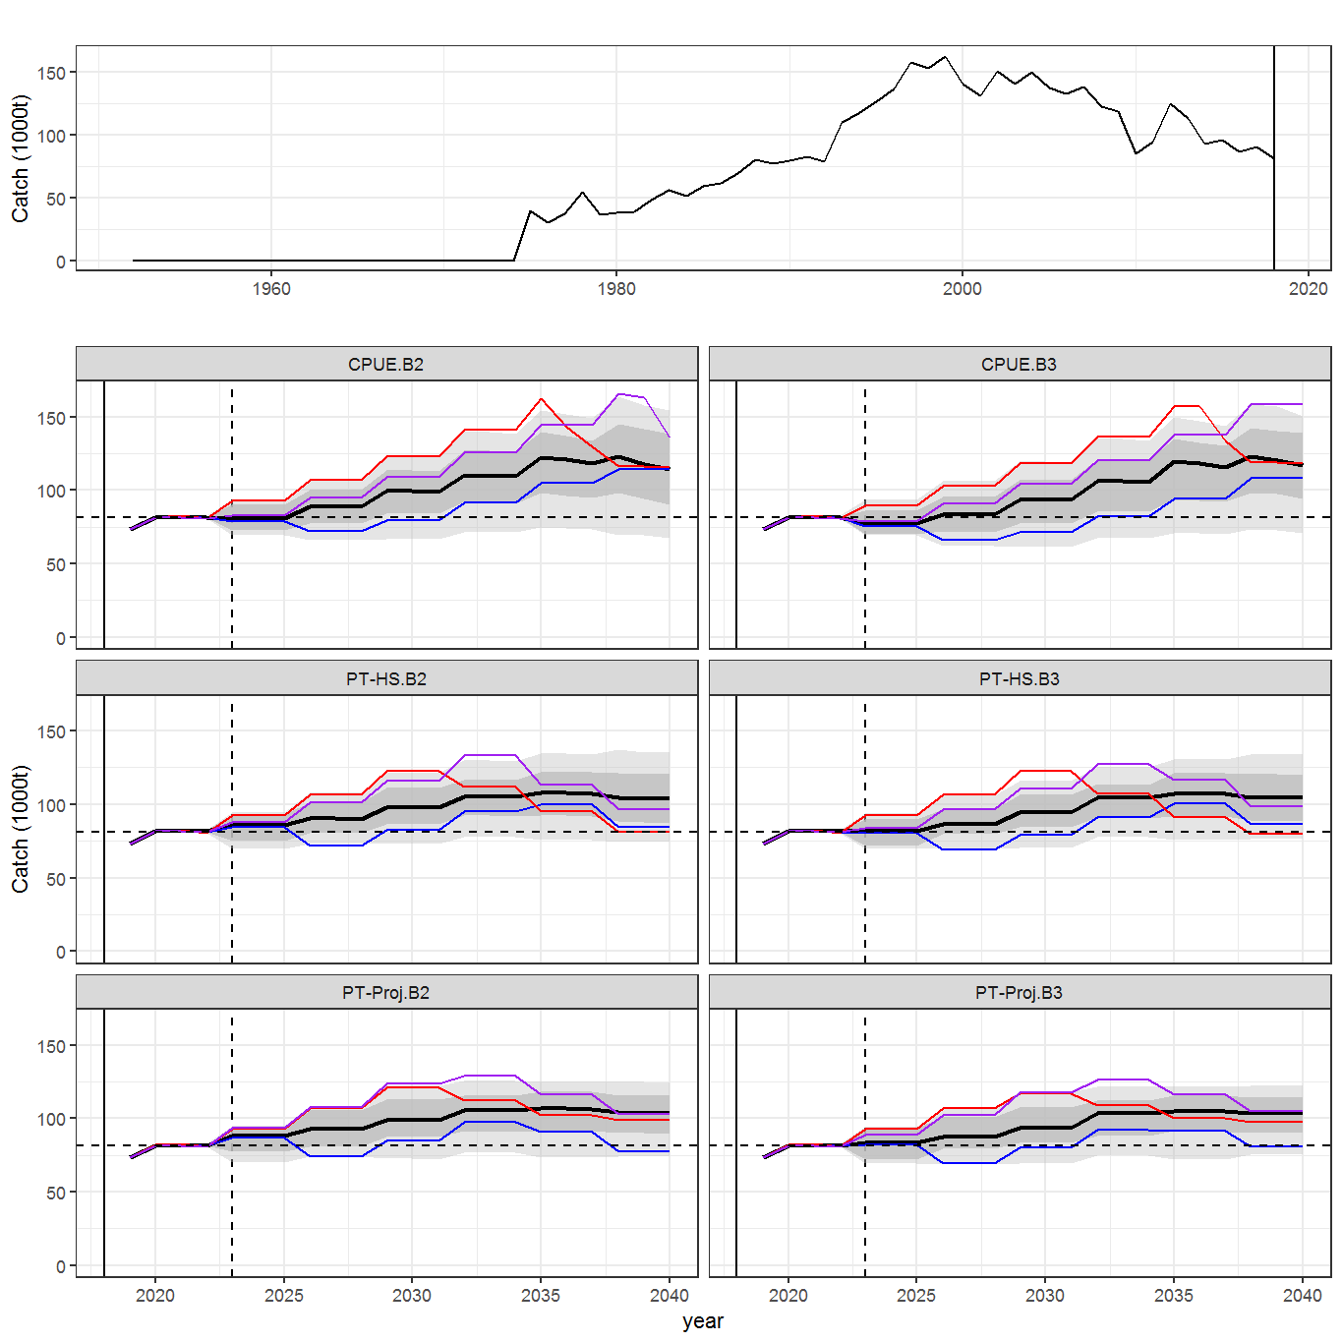
Key Results of Candidate MP Evaluations
Catch
Fig. 10
Tuning objective requires Catch increase from recent levels
Model-based MPs stabilize more quickly than CPUE based

Slide 16
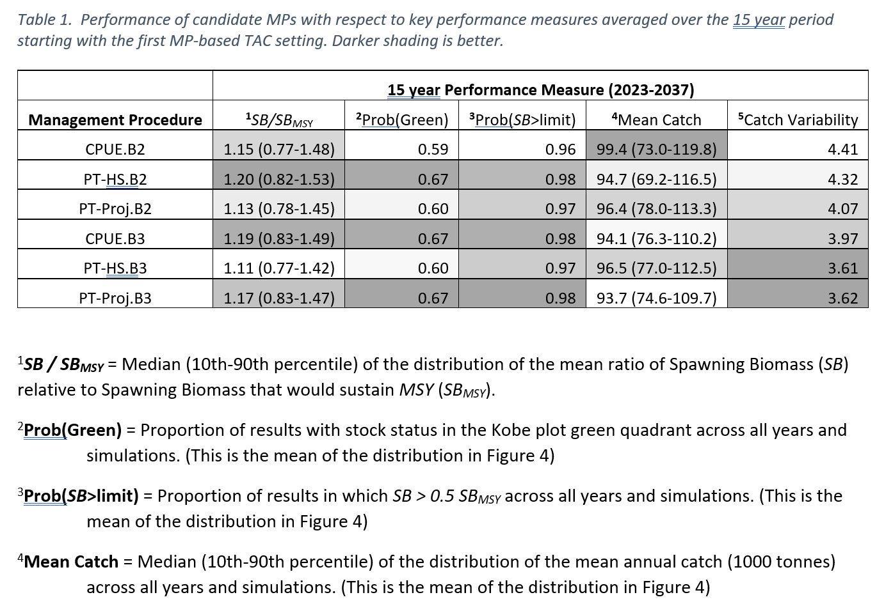
Summary Tables for 15 year MP Performance

Slide 17
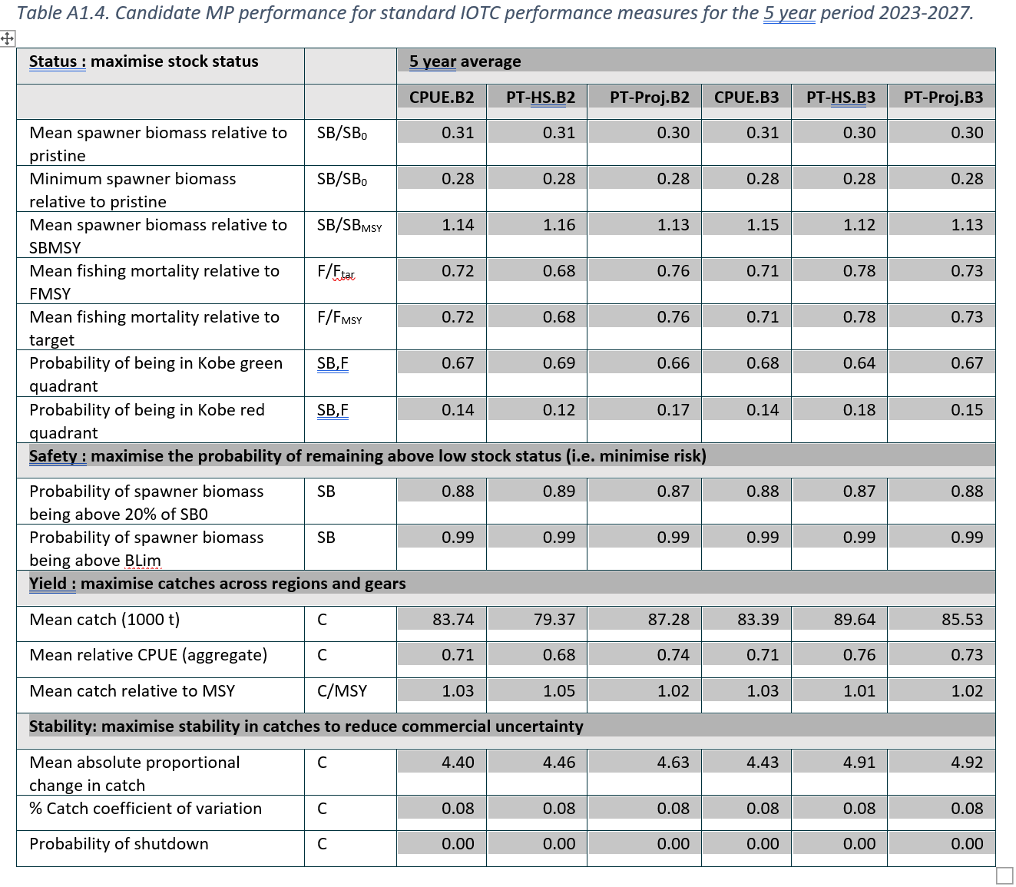
Report Appendix 1 – MP Performance Tables
More statistics
1,5,10,15,20 year
Summation periods

Slide 18
Report Appendix 2 – MP Robustness Tests
Reference Set Operating Model
Robustness Test Operating Models
“reasonably” likely ensemble of OMs
Used to tune MPs
Less likely, but “plausible” and potentially troublesome OMs
Pre-Tuned MPs tested
May identify catastrophic risks
May discriminate among MPs that perform similarly with reference set.

Slide 19
Report Appendix 2 – MP Robustness Tests
What happens if:
Recruitment failure?
Longline CPUE becomes less reliable?
10% over-catch reported accurately?
10% over-catch unreported?
10% over-catch (half of which is reported)?
Longline CPUE becomes biased (under-estimates abundance decline)?
5 year period (2020-2024) in which industry drops catch by 20% from recent levels (or under-catches the TAC by 20%) before the quotas become restrictive?

Slide 20
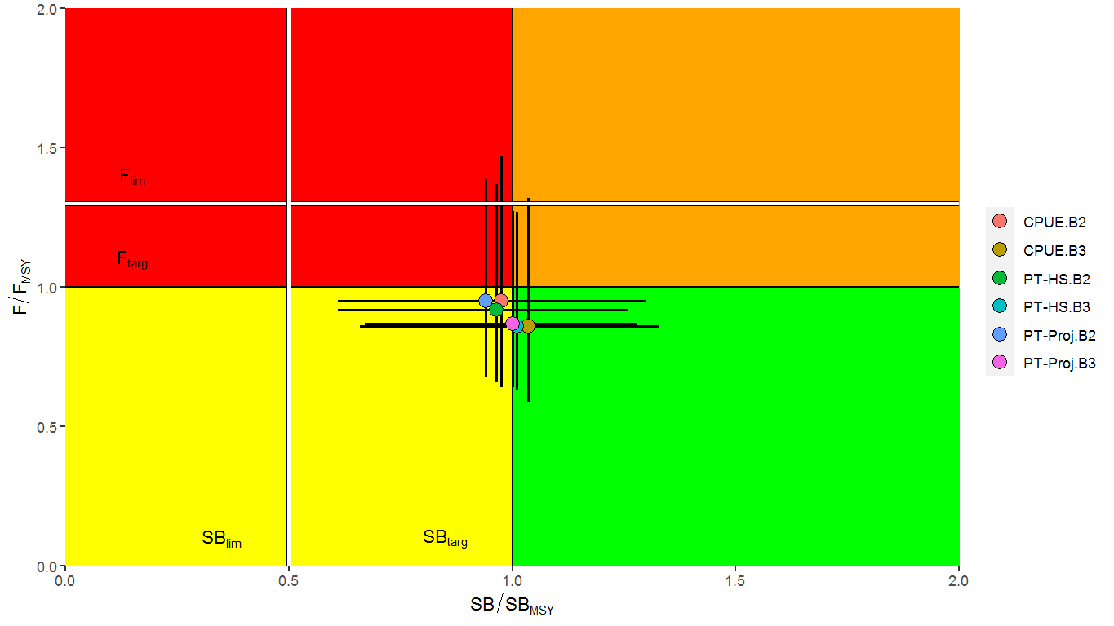
Report Appendix 2 – MP Robustness Test 1 8 quarters of poor recruitment
Reference Set
Poor Recruitment
Decline in average stock status
Biomass Limits unlikely to be breached

Slide 21
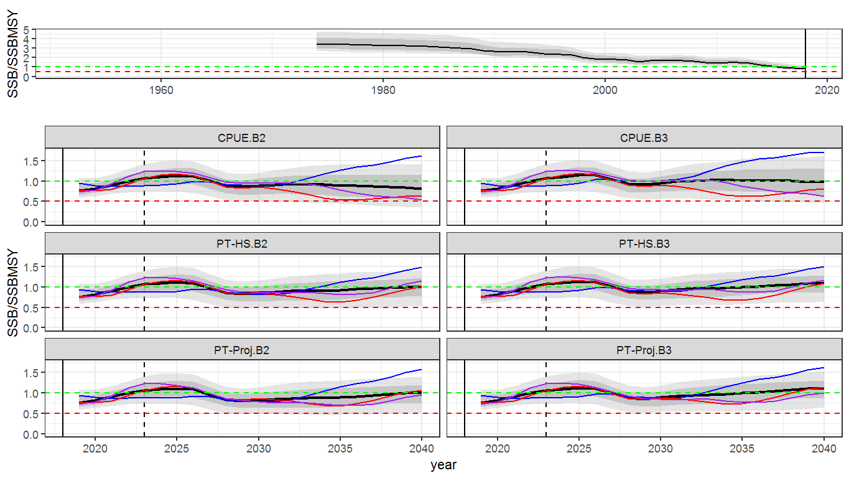
Report Appendix 2 – MP Robustness Test 1 8 quarters of poor recruitment
Spawning Biomass
Reference Set
Poor Recruitment
Biomass declines earlier, but stabilizes
All MPs similarly affected

Slide 22
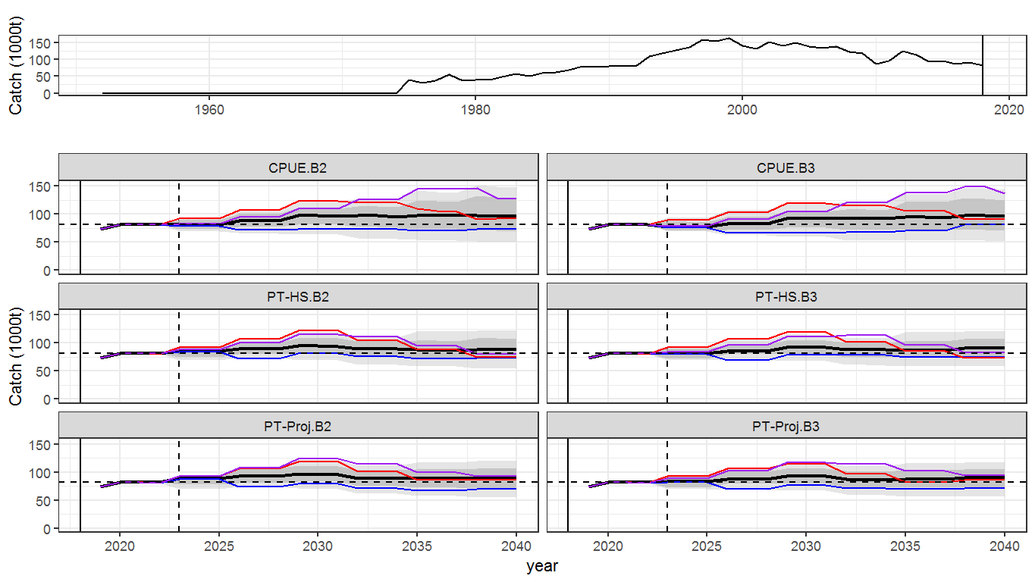
Report Appendix 2 – MP Robustness Test 1 8 quarters of poor recruitment
Catch
Reference Set
Poor Recruitment
Catch remains stable, likely above recent levels
All MPs similarly affected

Slide 23
Report Appendix 2 – MP Robustness Tests
The other 6 robustness tests have a similar or lesser effect on MP performance over the medium term
None of the Robustness tests provide much new information to help discriminate which MP would be preferable.

Slide 24
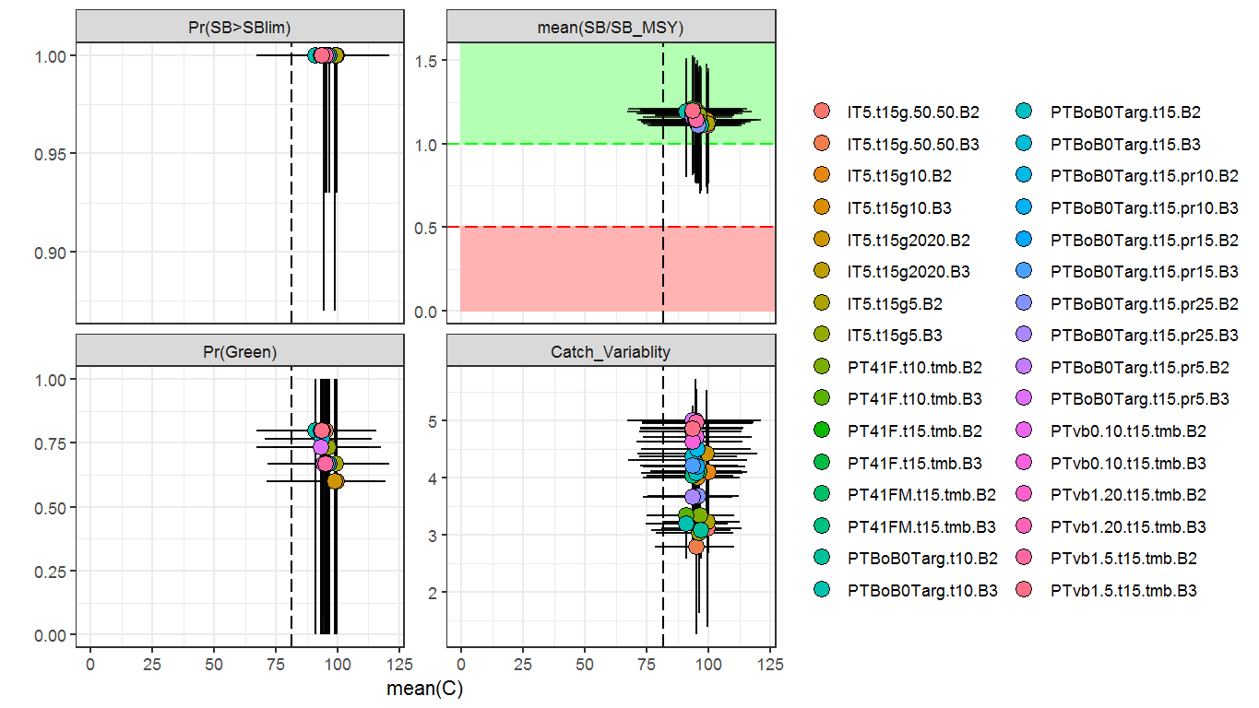
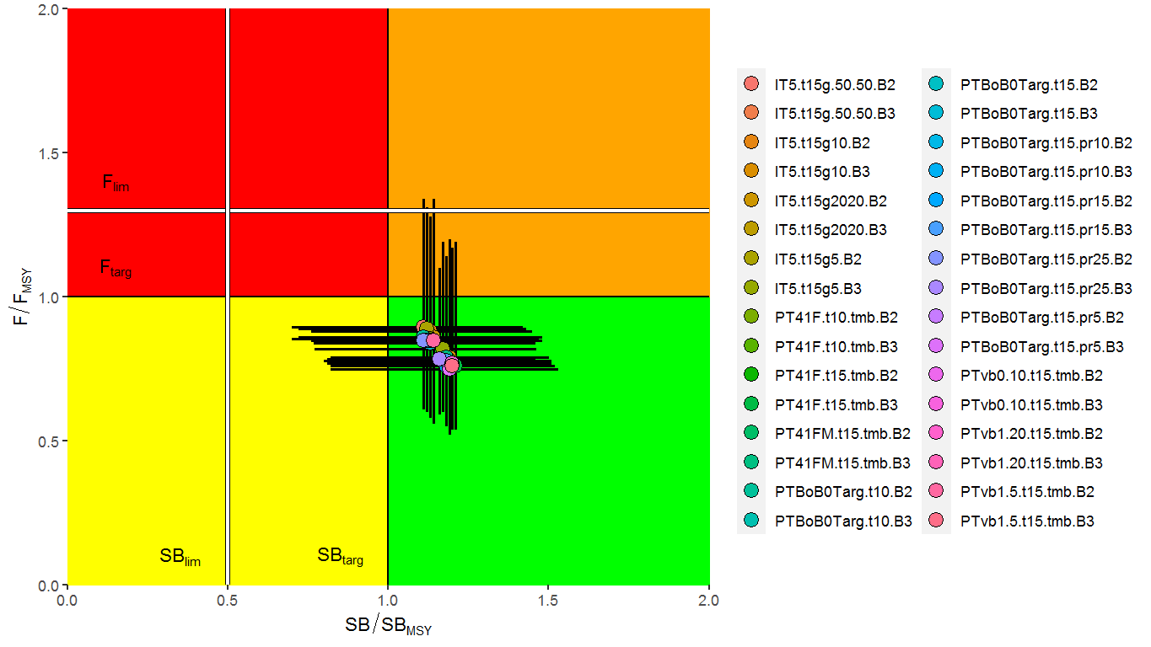
Report Appendix 3 – Miscellaneous MPs The 6 MPs presented are subset from 32 in Appendix 3
TCMP Tuning choice largely drives the performance

Slide 25
MP Performance Conclusions for Bigeye
All of the MPs tested represent low risk of exceeding SB limits.
All of the MPs tested are likely to recommend average catches that are higher than recent levels over the medium term.
Tuning objectives set by the TCMP largely determine the MP performance
All tuned MPs Perform similarly, however:
CPUE-based MPs:
Unstable biomass trends in the long term
greater catch variability
Projection-based MPs:
Biomass trends stabilize in the long term
lowest catch variability
Hockeystick MPs are intermediate

Slide 26
Considerations for next iteration
Operating Model still requires SC endorsement
Current bigeye stock status is not over-exploited.
Catches have been declining in recent years.
Tuning objectives tend to require substantial catch increases.
There appears to be no incentive for industry to increase catches at this time.

Slide 27
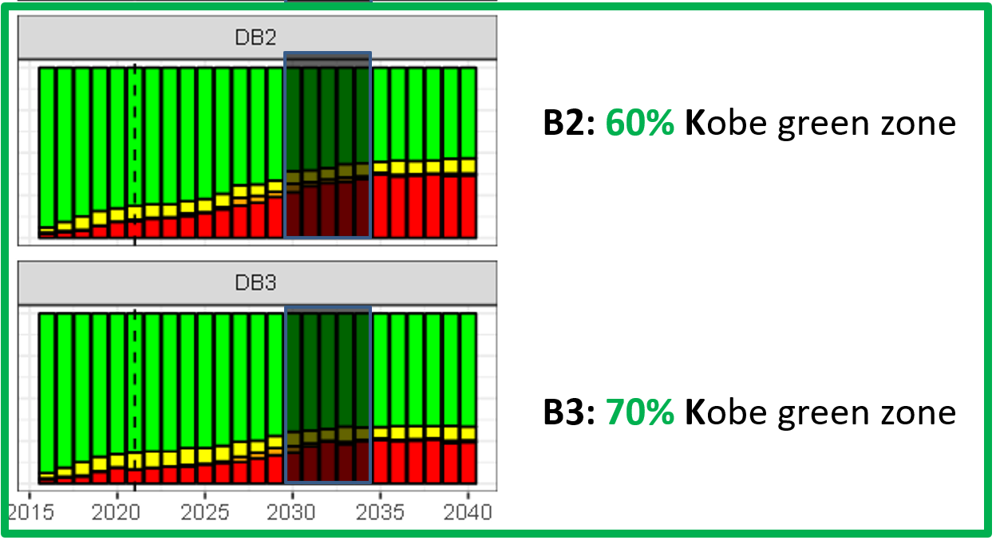
MP development questions for TCMP-04
Are B2 and B3 tuning objectives still appropriate?
Time Window: (2030-2034) or (first TAC +10y to first TAC +14y) ?

Slide 28
MP development questions for TCMP-04
Are B2 and B3 tuning objectives appropriate?
Frequency of quota setting?
First MP application 2022 for 2023 TAC setting?
Then every 3 years
15% TAC change constraint?
May be possible to increase initial stability
4) Implementation lag?
MP data (CPUE) available to 2021 for 2023 TAC
5) Are there any MP performance preferences?
e.g. Time series behaviour of catch and biomass?
6) Other TCMP concerns?

Slide 29
Merci
Thanks!

Slide 30
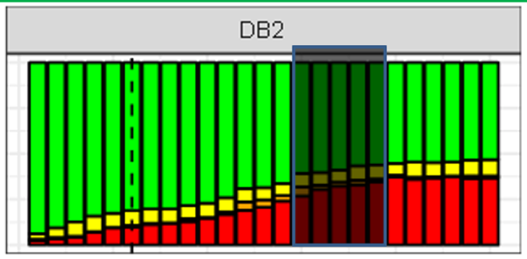
MP development questions for TCMP-04
Are B2 and B3 tuning objectives appropriate?
Could approximately translate to one of the standard performance graphics …
Pr(Green Kobe, 2030-2034) = 60%
1.2
Pr(average SB/SB(MSY) 2022-2037 > 1.2) = 50%

Slide 31
Bigeye Operating Model – Reference Set Ensemble from IOTC-2021-WPM12(MSE)-04)

